Slide 1
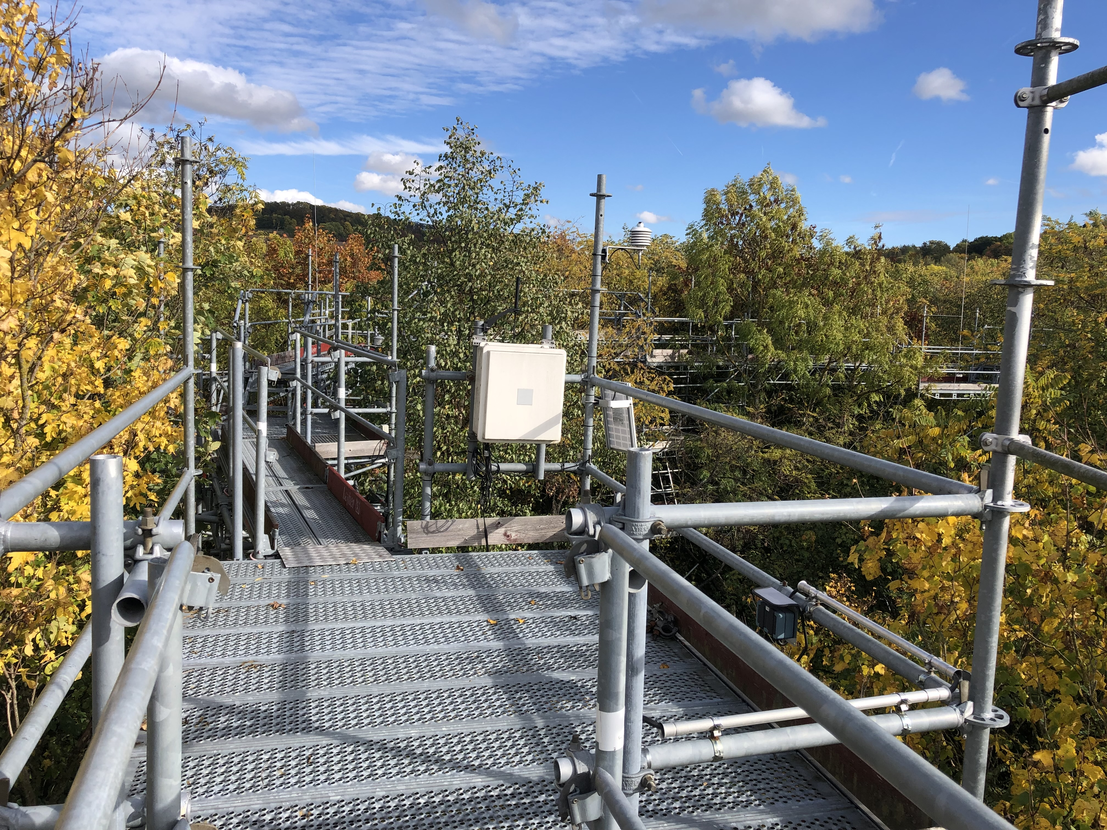



Sharath Paligi
17th June 2024

Slide 2
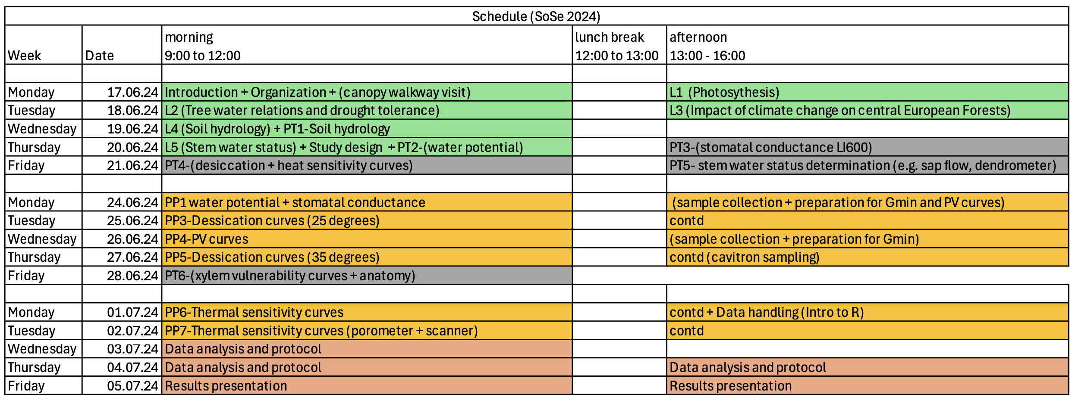
Schedule of the course
Any conflicts with data and time?
(Optional) 3rd July: Feedback on presentation preparation or tutoring related to data analysis

Slide 3
Course evaluation
Presentation
Pick your species
Pick your topic
Total – 12 minutes
10 minute presentation
Literature: 5 – 6 minutes
General ecology and drought tolerance of chosen species (1-2 min)
Results: 2- 5 minutes
Discussion: 2 minutes
Report
Background
Study questions
Hypothesis

Slide 4
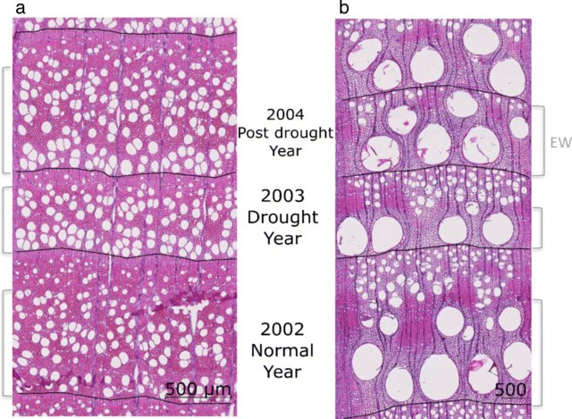
Species of interest
Tilia cordata
Acer platanoides
Robinia pseudoacacia
Fraxinus excelsior
Diffuse porous
Ring porous
Schwarz et al. 2020

Slide 5
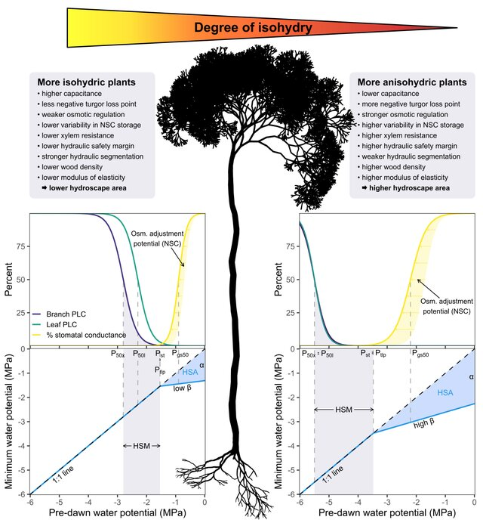
Water status regulation
Isohydric
Tilia cordata
Acer platanoides
Anisohydric
Robinia pseudoacacia
Fraxinus excelsior
Hartmann et al. 2020

